Slide 1
KLU Design Thinking for Innovation BLOOD SHORTAGE : A Threat to life Work In Progress Submission 2
Department :CSE Section :10 Batch:5

Slide 2
Project Team - Introduction
S.NO | ID.NO | Name | Role in the project
1 | 2320030349 | K Sai Prasad | Team leader and chief developer
2 | 2320030324 | Y M V Shivaram | Co-developer and designing the low fidelity prototype
3 | 2320030364 | G Varshitha | Co-developer and designing the outlook of the homepage
4 | 2320030388 | JAJULA YASHWANTH | Co-developer and designing the outlook of the homepage
5 | 2320030278 | Ch.Sai Deekshita | Ppt creator
6 | 2320030038 | G.Padmaja | Ppt creator
Trainer: SRI LAKSHMI Mentor: M.RAJU

Slide 3
Problem Statement: Many patients are unable to find the blood, in required time making it difficult for the doctor to successfully complete the operation and save the patients.

Slide 4
Ideate:
1.Public Awareness Campaigns
3.Social Media Challenges.
2.Education Programs.
4.Collaboration with Religious Institutions.

Slide 5
5.Mobile Apps and websites.
6.Continuous Communication.
7.Partnerships.
8.Easy Registration and Appointment Systems.

Slide 6
1. Our Most Important Learnings
1.Constant Need for Blood Donation Education:
One of the primary reasons for blood shortages is often a lack of awareness about the importance of regular blood donation.
2. Organized Blood Donation Drives and Systems:
Blood shortages can be mitigated by establishing and maintaining organized blood donation drives and systems.
3. Diversity and Inclusivity in Blood Donors:
Another key learning is the importance of promoting diversity and inclusivity among blood donors. Blood shortages can be exacerbated when specific demographic groups are underrepresented in blood donation efforts.

Slide 7
2. Other Things We Learned
1.Regular Health Check-ups and Eligibility
2. Utilizing Social Media for Awareness
3. Emergency Preparedness
4. Local Community Engagement
5. Feedback Loops for Improvement

Slide 8
Low Fidelity prototype
Select to view the list of volunteers of your required blood group
Rh factors Blood prediction
IF you wish join us contact us at
You will be directed to the list of volunteers
In the search bar add your nearest location to find the donor near you and contact them using their phone numbers
Home page
Kindly select the preferred language
About us
Why us
You will be directed to the web page where you can find the information about Rh factor
On clicking the blood prediction, you will be directed to a list blood of both parents and the probability of their child’s blood group.

Slide 9
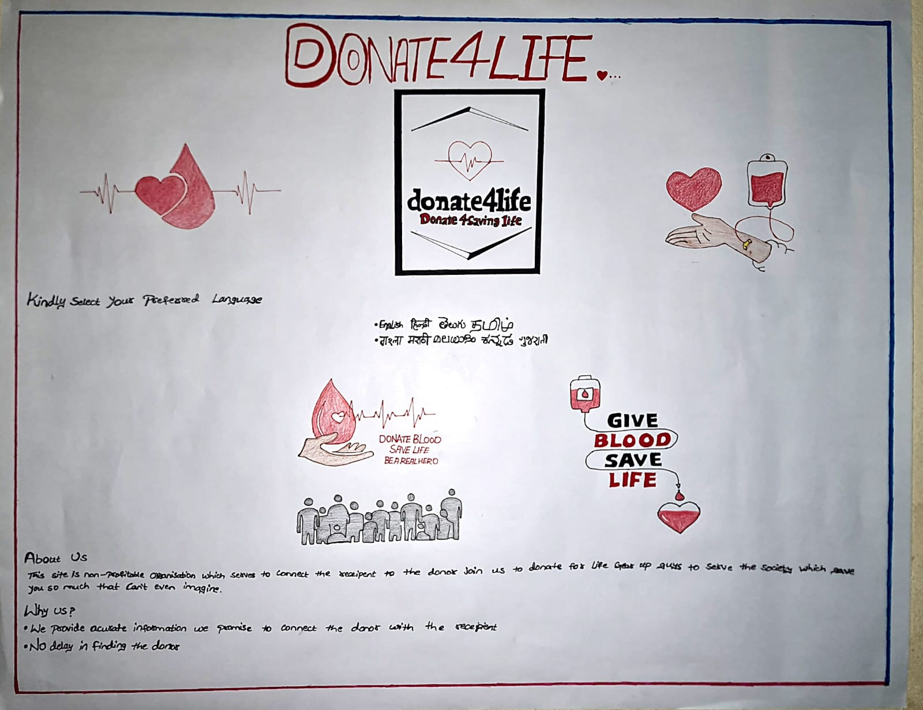

Slide 10
DOnate4life Business Model Canvas
KEY RESOURCES
Apps on website
Employees
KEY ACTIVITYIES
Marketing
Content distribution
Content production
VALUE PROPOSITION
24/7 service
Unlimited access
No commercials
CUSTOMER RELATIONSHIPS
Self service
On demand
Ease of use
KEY PARTNERS
Investors
Hospitals
Blood banks
Volunteers who are willing to donate and blood donation
Revenue streams
Partnership with private hospitals and blood bank
In app donation
Premium services
COST STRUCTURE
Marketing
Payment processing fees
General or admin
Customer segments
Usage segmentation geographical
Content/l-anguages
COST STRUCTURE
Production
Research and
Developme-nt
Channels
Any device
Word of mouth
Online and offline advertisement
Social Media

Slide 11
Financial Estimation
Total grand total:
Rs.1500000-3700000per month
Website development: ₹200,000 - ₹500,000 per year
Mobile app development:₹200,000 - ₹500,000 per year
Database development: ₹200,000 - ₹500,000 per year
User interface (UI) and user experience (UX) design: 1,00,00-2,00,000
Grand total
Development costs: Rs.700000 Rs.1700000 per year
Management:
Costs:300000-920000
Other considerations:
5,00,000-10,00,000 per year
Web hosting:Rs.2,000-10,000 per month
Domain name registration: ₹5,000 - ₹10,000 per year
Email marketing: Rs.2000 – Rs.5000 per month
Customer support: Rs.20000 – Rs.50000 per month
Marketing and advertising: ₹200000 - ₹5,00,000 per year
Partnerships with blood banks and hospitals: Free – Rs10,000per month
Staffing: 5000000-6000000per month

Slide 12


